Slide 1
Aggregates, unions, subqueries

Slide 2
Aggregate functions
SUM, MIN, MAX, AVG, COUNT etc
Commonly used in various calculations
Tied to GROUP BY when you calculating values for groups
You can aggregate not only numbers, but text and other data types
Basic structure:
SELECT <fields_list>, AGG_FUNCTION (calculated_field)
FROM <table>
WHERE <condition>
GROUP BY <fields_list>

Slide 3
Aggregate functions examples
Simple aggregations:
select sum (price) from public.boryspil_flights; -- total price of all flights from Boryspil
select min (price) from public.boryspil_flights where flight_company = 'UIA'; -- cheapest flight from UIA
select flight_company, avg (price) as avg_price
from public.boryspil_flights
group by flight_company; -- average price per company
select count (*) from public.boryspil_flights where is_promo = true; -- number of promo flights
select bf.flight_company, SUM (price*profit_rate) as total_profit
from public.boryspil_flights bf
left join public.profit_rates pr on bf.flight_company = pr.flight_company
group by bf.flight_company;
Compare it to:
select bf.flight_company, SUM (price*COALESCE(profit_rate, 0.05)) as total_profit
from public.boryspil_flights bf
left join public.profit_rates pr on bf.flight_company = pr.flight_company
group by bf.flight_company; -- total profit per company, COALESCE in action.
--text aggregation:
select string_agg(flight_company, flight_destination)
from public.boryspil_flights

Slide 4
HAVING and aggregate functions
It’s like WHERE, but for aggregated results. You filter out not specific values, but their aggregation (sum, avegare, count etc)
General syntax:
SELECT <fields list>, AGG_FUNCTION (field)
FROM <table_name>
[JOINS]
WHERE <condition on specific field(s) value>
GROUP BY <fields_list>
HAVING <condition on aggregated value>
Practice example:
select flight_company, SUM (price) as total_sum
from public.boryspil_flights
where flight_company !='UIA'
group by flight_company
having sum (price) > 500;

Slide 5
Subqueries
They are the same queries, and in general we treat them like a table
When you use subqueries in joins – you have to specify an alias and include subquery into parentheses
A subquery must be placed on the right side of the comparison operator
Subqueries don’t end with ; (semicolon)

Slide 6
Subqueries with SELECT
create table public.b_important_cities (city text, is_military boolean);
insert into public.b_important_cities (city, is_military)
values ('New York', FALSE), ('Washington', TRUE), ('Los Angeles', FALSE), ('Denver', TRUE), ('El Paso', FALSE);
Subquery in WHERE clause
select distinct ft.scheduled_departure::date as scheduled_date
from bookings.flights ft
join bookings.airports ap on ap.airport_code = ft.departure_airport
where ap.city in
(select city from public.b_important_cities where is_military=FALSE)
and ft.status = 'Delayed';
Subquery as a table in JOIN
select distinct ft.scheduled_departure::date
from bookings.flights ft
join bookings.airports ap on ap.airport_code = ft.departure_airport
join (select city from public.b_important_cities where is_military=FALSE) ic on ic.city = ap.city
where ft.status = 'Delayed’
Subquery with aggregates
select avg (t.cnt) as avg_flights
from (
select ac.model, count (f.*) as cnt
from bookings.flights f
join bookings.aircrafts ac on ac.aircraft_code = f.aircraft_code
join bookings.airports a on a.airport_code = f.departure_airport
where f.actual_departure::date = '2016-09-01' and a.city = 'Rochester'
group by ac.model) t

Slide 7
Subqueries with INSERT, DELETE
create table public.b_airports_selected (airport_code text, city text, aircraft_model text, departure_date date);
INSERT a result of subquery into table:
insert into public.b_airports_selected (airport_code, city, aircraft_model, departure_date) -- OUTER (main) QUERY
(select distinct ft.arrival_airport as airport_code, arr.city, ac.model as aircraft_model,
ft.actual_departure::date as departure_date
from bookings.flights ft
join bookings.airports dep on ft.departure_airport = dep.airport_code -- we join this table twice,
join bookings.airports arr on ft.arrival_airport = arr.airport_code -- for arr-l and dep-t airports
join bookings.aircrafts ac on ft.aircraft_code = ac.aircraft_code
where dep.city = 'El Paso' and ft.scheduled_arrival between '2016-08-05' and '2016-08-30');
DELETE rows from a table based on subquery:
delete from public.b_airports_selected -- OUTER (main) QUERY
where departure_date IN (
select distinct ft.actual_departure::date as departure_dat
from bookings.flights ft -- "central fact table"
join bookings.airports dep on ft.departure_airport = dep.airport_code
join bookings.airports arr on ft.arrival_airport = arr.airport_code -- to get city filter/info
join bookings.aircrafts ac on ft.aircraft_code = ac.aircraft_code -- to get aircraft info/filter
where dep.city = 'Detroit' and arr.city = 'New York' and ft.scheduled_arrival between '2016-08-05' and '2016-08-30'
);
SUBQUERY
SUBQUERY

Slide 8
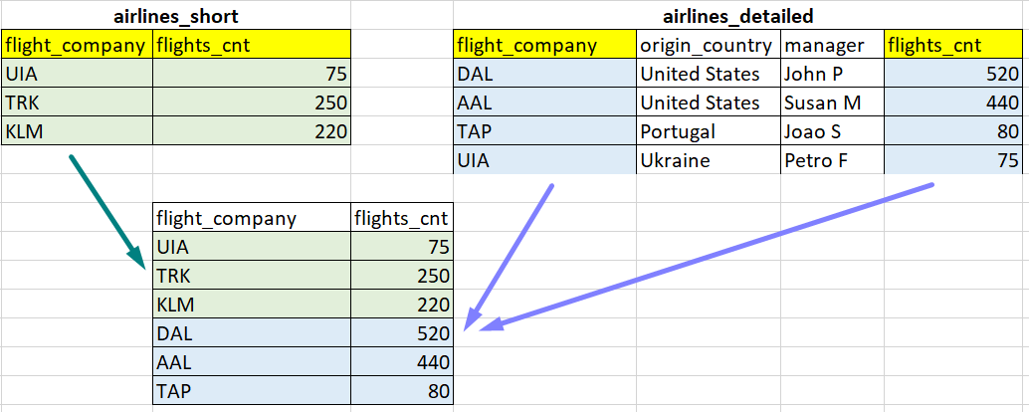
UNION
create table public.airlines_short (flight_company text, flights_cnt int);
create table public.airlines_detailed (flight_company text, origin_country text, manager text, flights_cnt int);
insert into public.airlines_short values ('UIA', 75), ('TRK', 250), ('KLM', 220);
insert into public.airlines_detailed values ('DAL','United States','John P',520), ('AAL','United States','Susan M',440),
('TAP','Portugal','Joao S',80),('UIA','Ukraine','Petro F',75);
SELECT flight_company, flights_cnt
FROM airlines_short
UNION
SELECT flight_company, flights_cnt
FROM airlines_detailed;
The UNION operator is used to combine the result-set of two or more SELECT statements.
Column names in the results HAVE NOT to be equal
Number of columns of united queries have to be equal
Data types have to be the same per each column
UNION vs UNION ALL:
UNION ALL combines 2 whole datasets
UNION eliminates duplicates
EXCEPT and INTERSECT
INTERSECT keeps only common values
EXCEPT lists the rows in the first that are not in the second.
SELECT flight_company, flights_cnt
FROM airlines_short
INTERSECT -- only common values
SELECT flight_company, flights_cnt
FROM airlines_detailed;
SELECT flight_company, flights_cnt
FROM airlines_short
EXCEPT -- rows from 1st, but not in 2nd
SELECT flight_company, flights_cnt
FROM airlines_detailed;

Slide 9
CREATE TABLE AS SELECT (CTAS)
CREATE TABLE AS SELECT <query> allow you to create a new table filled with results of a query
Columns data types of new tables determines by server automatically
New table doesn’t inherit indexes, keys, constraints etc
Examples:
create table public.b_random_flights AS
select * from bookings.flights limit 100;
create table public.b_el_paso_flights AS
select distinct ft.arrival_airport as airport_code, arr.city, ac.model as aircraft_model,
ft.actual_departure::date as departure_date
from bookings.flights ft -- "central fact table"
join bookings.airports dep on ft.departure_airport = dep.airport_code
join bookings.airports arr on ft.arrival_airport = arr.airport_code -- to get city filter/info
join bookings.aircrafts ac on ft.aircraft_code = ac.aircraft_code -- to get aircraft info/filter
where dep.city = 'El Paso' and ft.scheduled_arrival between '2016-08-05' and '2016-08-30';

Slide 10
UPDATE basics
UPDATE changes the values of the specified columns in all rows that satisfy the condition. Only the columns to be modified need be mentioned in the SET clause; columns not explicitly modified retain their previous values.
As new updated value you can use a constant value, expression or other columns’ value
!!! Without WHERE condition, UPDATE will assign new values for specific column for all rows, always check for it
Basic syntax:
UPDATE <table_name> SET <column> = <value> [WHERE <condition>]
Examples:
update public.products_stock set quantity = 100 where product_name = 'H&S Shampoo';
Update public.products_stock set quantity = (quantity * 2) where product_supplier = 'Apple';
update public.products_stock set expiration_date = '2023-01-01' where price > 1000;

Slide 11
Q&A/Homework
General: don’t use views routes and flights_v in bookings schema yet, stick to tables only.
A. Output from bookings schema:
10 passengers, who flew from New York and their summary amount spent on bookings > $1000, sorted alphabetically
# of flights from Newark to San Diego
# of flights from Tucumcari when seat 3A was occupied
Min, Max and Average number of passengers per flight on route from Cincinnati to Newark
Complete list of all cities and # of departure flights per each city during 2016-08-01. There should be no duplicates.
B. Create new work table (b_ny_flights) in public schema. Insert into it data for all flights from New York during Aug-Sept 2016. Table structure is up to you, but consider further instructions.
Output the # of destination cities for flights in work table
Delete all flights from work table that have Chicago and Los Angeles as destination
Output the list of destination cities for New York departure flights from booking.flights table, which are absent in new work table. Do not use date filters on booking.flights table!
C. Output from table you’ve created during homework #1 (with products like iPhone, Varvar):
1. Total stock value (price * quantity) per supplier
2. Product with minimal price per supplier
3. Average price across all products
4. Count of products cost less than 1000 per supplier

Slide 12
Links to read
https://learnsql.com/blog/beginners-guide-sql-aggregate-functions/
https://www.w3resource.com/sql/subqueries/understanding-sql-subqueries.php
https://www.sqlshack.com/sql-union-overview-usage-and-examples/
https://learnsql.com/blog/introduction-using-aggregate-functions-joins/
https://edu.postgrespro.ru/bookings.pdf (rus) - description of bookings schema
https://www.w3schools.com/sql/sql_update.asp
https://www.postgresql.org/docs/14/sql-update.html

